Slide 1
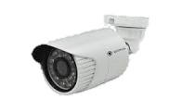
Advanced Ml project
Presented by-
Satyam Kumar Singh(21bcs11016)
Aniket (21bcs10906)
Hardik Jain(21bcs10861)

Slide 2
Content
Introduction​
Problem Statement
​Methodology
Key features
Deliverables

Slide 3

Vehicle Accident Detection using
Computer Vision

Slide 4
Introduction to problem
Traffic accidents are a persistent and devastating problem on our roads.
These accidents occur suddenly and without warning, leading to loss of life and injuries.
Thousands of lives are lost annually due to traffic accidents.
Swift response to accidents is crucial to minimize their impact.
Technology can play a pivotal role in addressing this critical issue.

Slide 5
Problem statement
The problem: Traffic accidents on roadways pose a significant threat to public safety, resulting in loss of life, injuries, and property damage.
Lack of timely detection: Accidents often go unnoticed or are reported too late, hampering emergency response efforts.
Inefficient manual reporting: Relying solely on eyewitness accounts or manual reporting can lead to inaccuracies and delays in response.
Limited resources: Emergency services are stretched thin, and efficient allocation of resources is crucial for optimal accident response.
Potential for improvement: The integration of computer vision and AI technologies offers a promising solution to enhance accident detection, response times, and overall road safety.

Slide 6
Methodology
Data Collection:
Install high-resolution cameras and sensors at strategic locations on roadways.
Continuously capture images or video footage of the monitored area.
Data Preprocessing:
Clean and preprocess the collected data to remove noise and enhance image quality.
Segment relevant portions of the images or videos, focusing on the road and surrounding areas.
Object Detection:
Utilize computer vision algorithms like YOLO (You Only Look Once) or SSD (Single Shot MultiBox Detector) to identify and track vehicles, pedestrians, and other objects on the road.
Anomaly Detection:
Implement anomaly detection algorithms that analyze the behavior and interactions of detected objects.
Look for irregular patterns such as sudden stops, collisions, or unexpected movements.
Contextual Analysis:
Incorporate contextual information into the analysis, including data on vehicle speed, direction, and road conditions.
Use this information to determine if detected anomalies are likely to be accidents.
Alert Generation:
When a potential accident is detected, trigger an alert or alarm.
Send real-time notifications to relevant stakeholders, such as emergency services or traffic management authorities.
Testing and Optimization:
Continuously monitor the system's performance and accuracy.
Fine-tune the algorithms and parameters based on real-world data and feedback.
Conduct thorough testing in various scenarios and conditions to ensure reliability.

Slide 7
Key features
Real-Time Detection: Instantly identifies accidents as they happen, enabling immediate response.
Object Recognition and Tracking: Advanced algorithms identify and monitor vehicles and objects on the road.
Anomaly Detection: Identifies irregular patterns like sudden stops or collisions, signaling potential accidents.
Contextual Analysis: Considers factors like speed and road conditions for more accurate assessments.
Alert System: Generates alerts for emergency services and authorities, facilitating swift response.

Slide 8
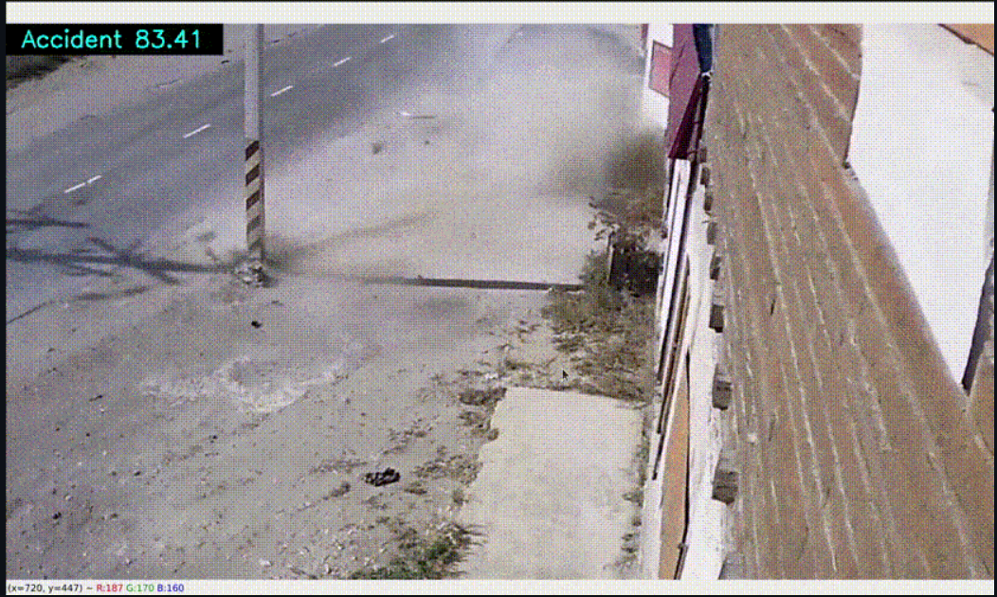
Deliverables
Accident Detection Software: Fully functional software for real-time accident detection. It would be a web app.
Configured Hardware: Installed and configured cameras, sensors, and necessary hardware.
Algorithm Implementation: Implemented computer vision algorithms for accident detection. It will be using Open CV, Tensor flow and Kera’s.
Validation Reports: Testing and validation reports demonstrating system accuracy.
Documentation: Technical documentation and user manuals.

Slide 9
THANK YOU

